Slide 1



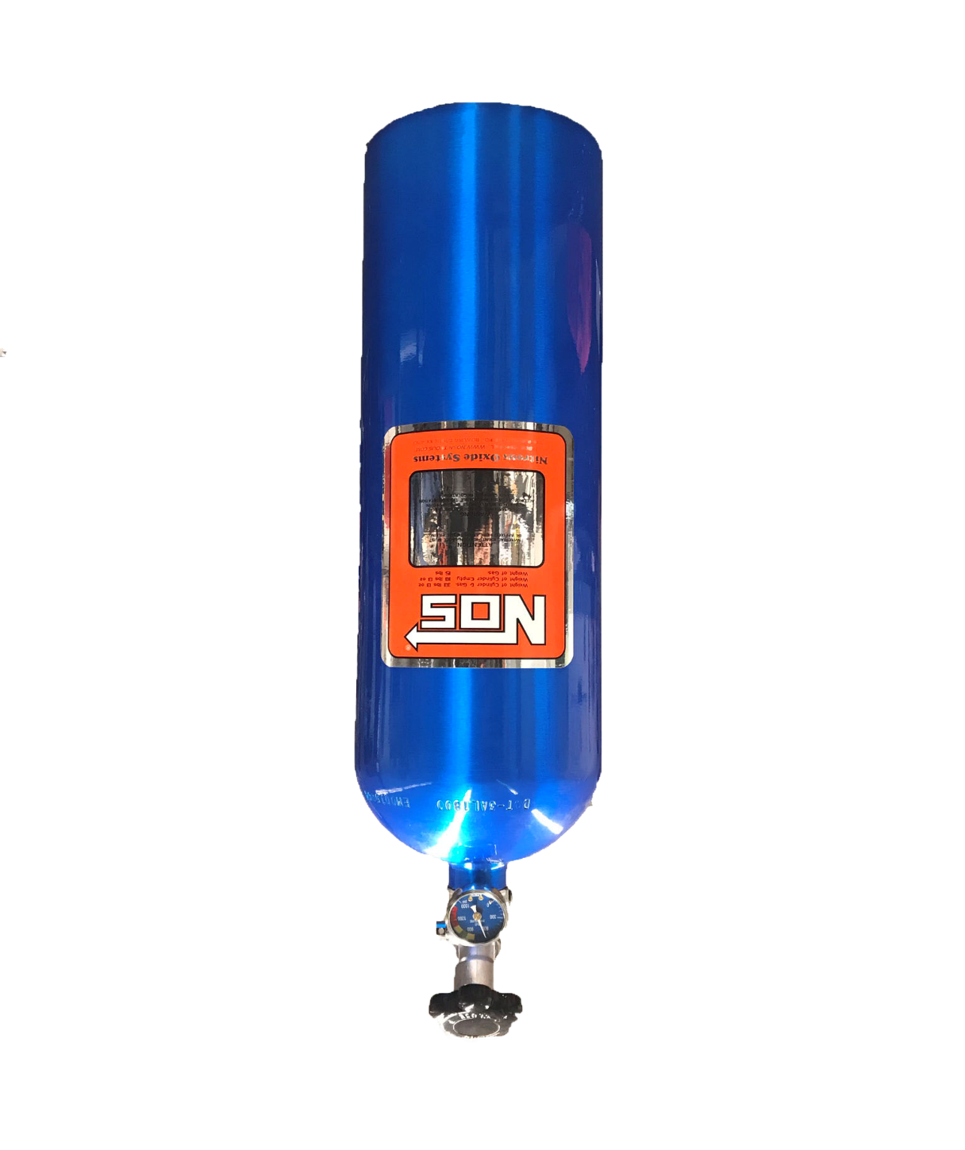
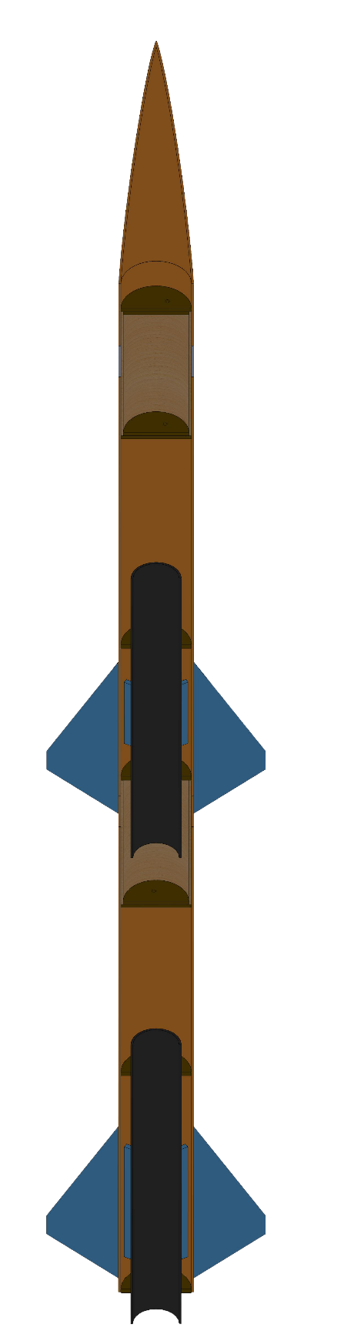
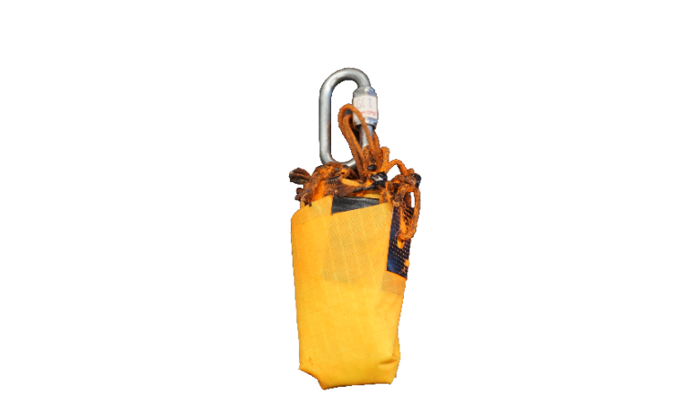
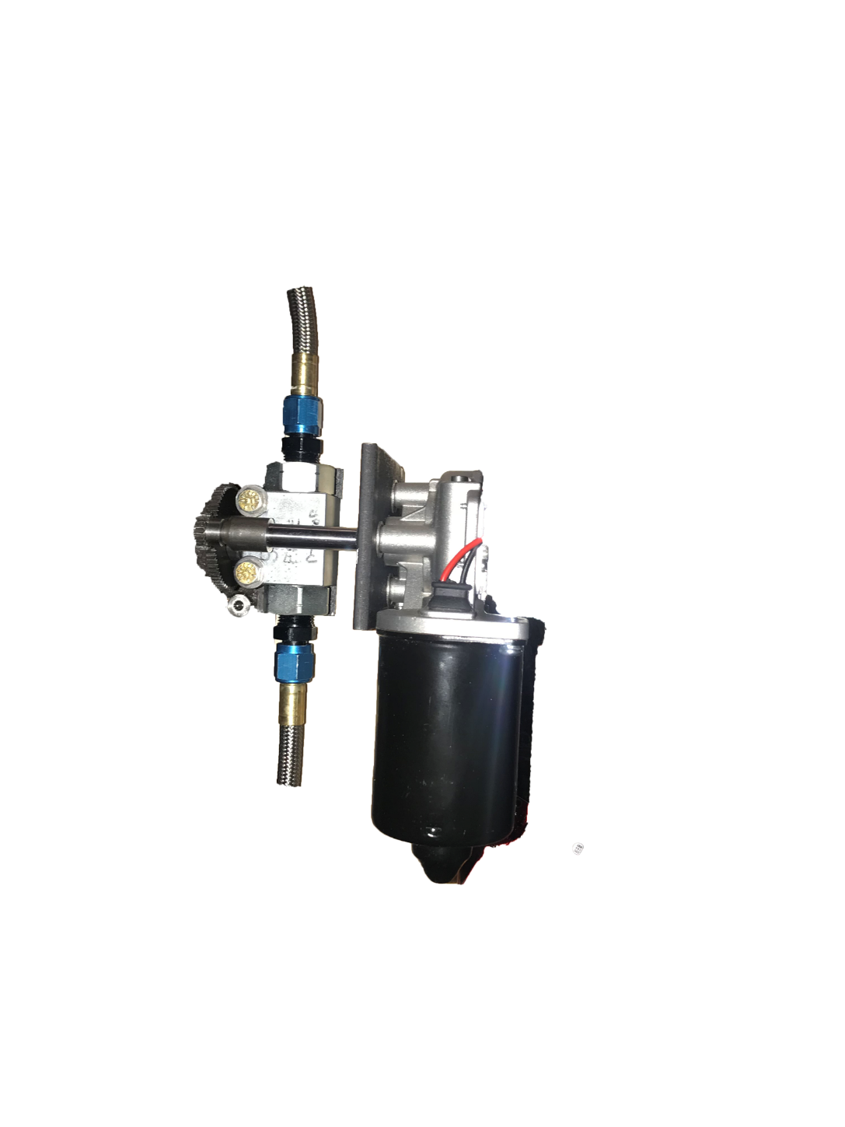
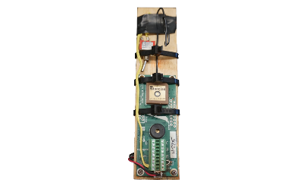
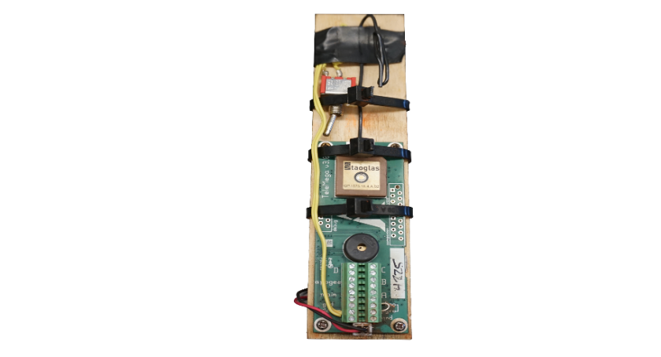
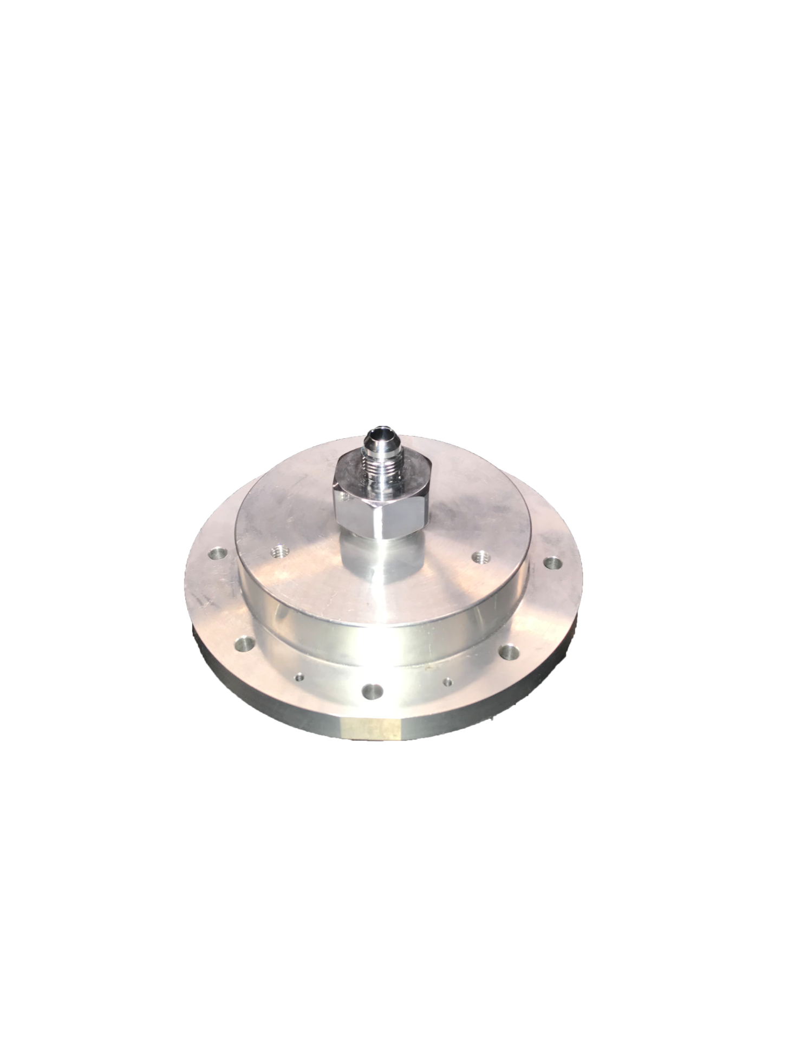
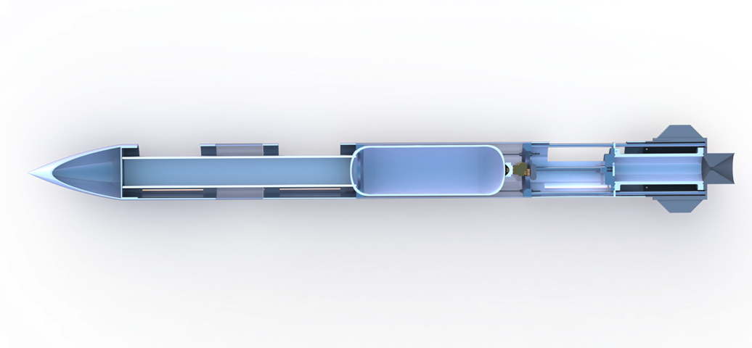
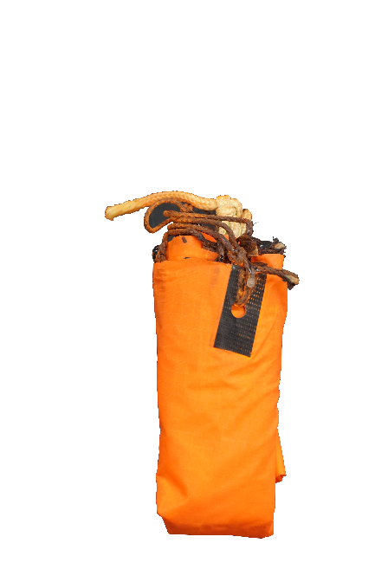

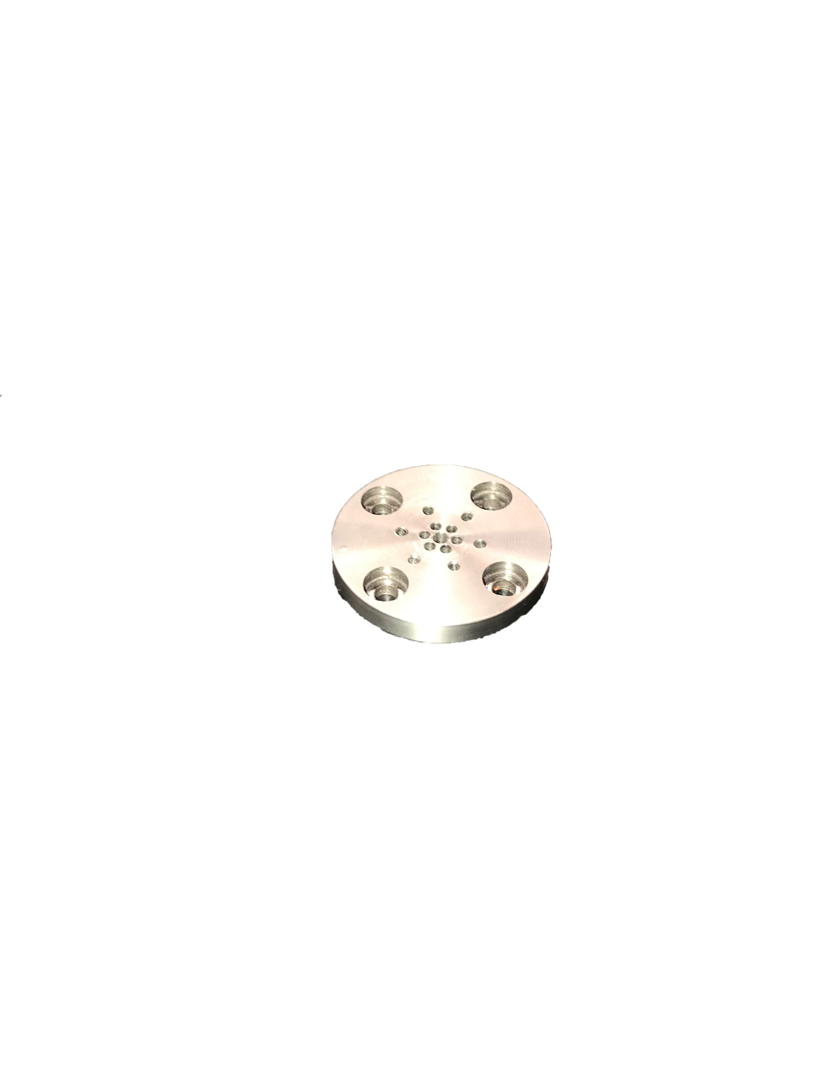
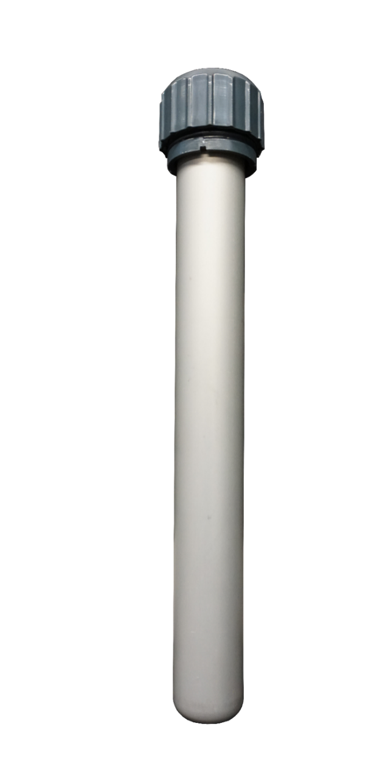
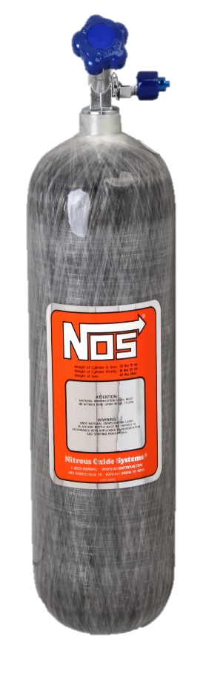
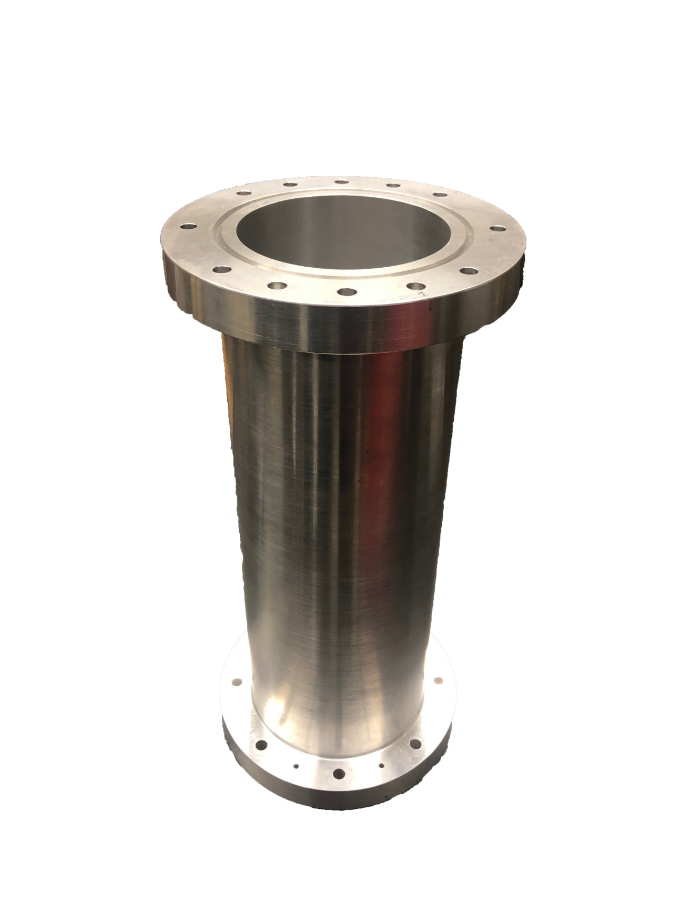
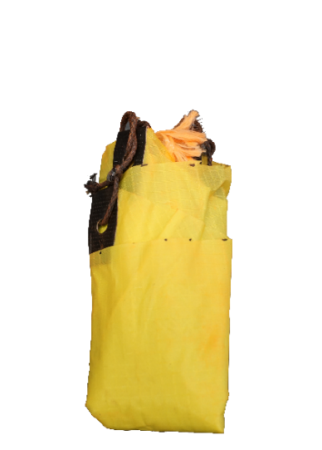
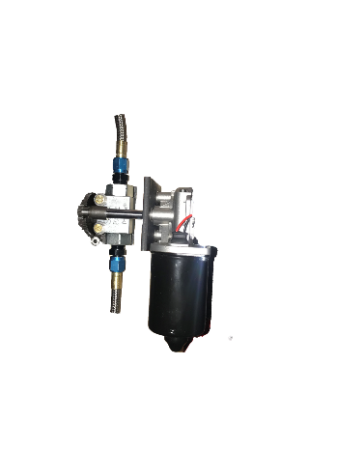

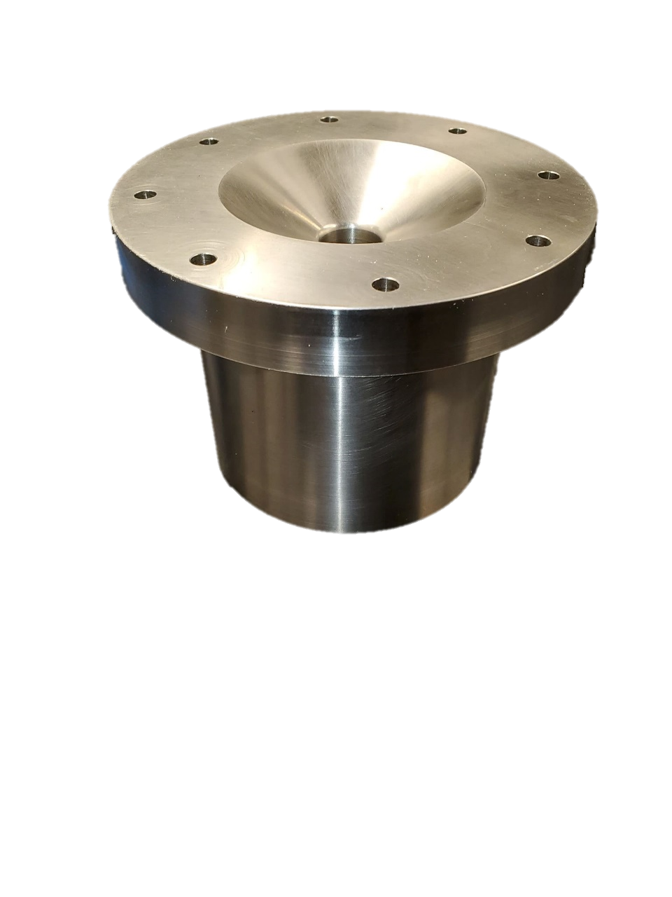
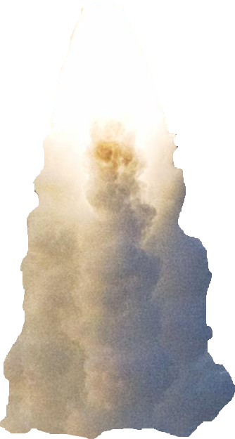
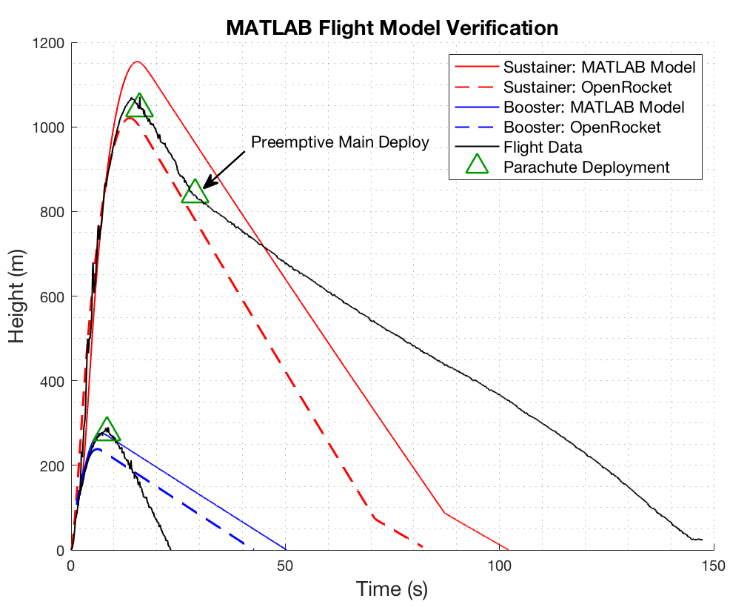
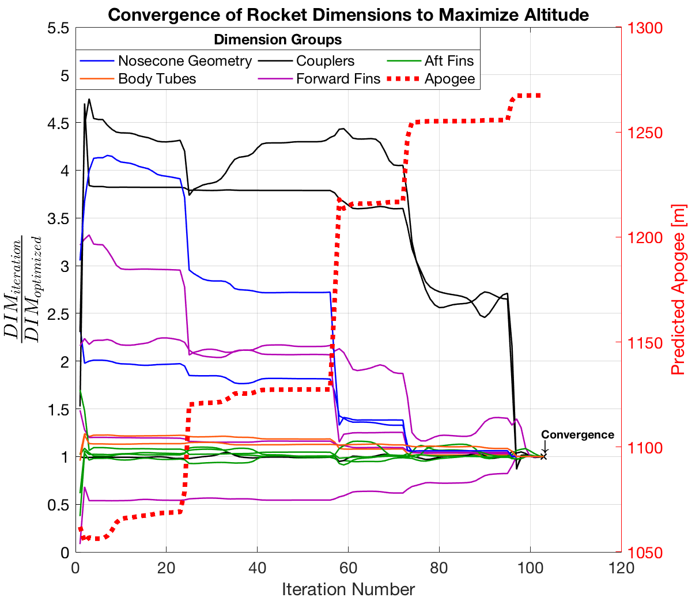
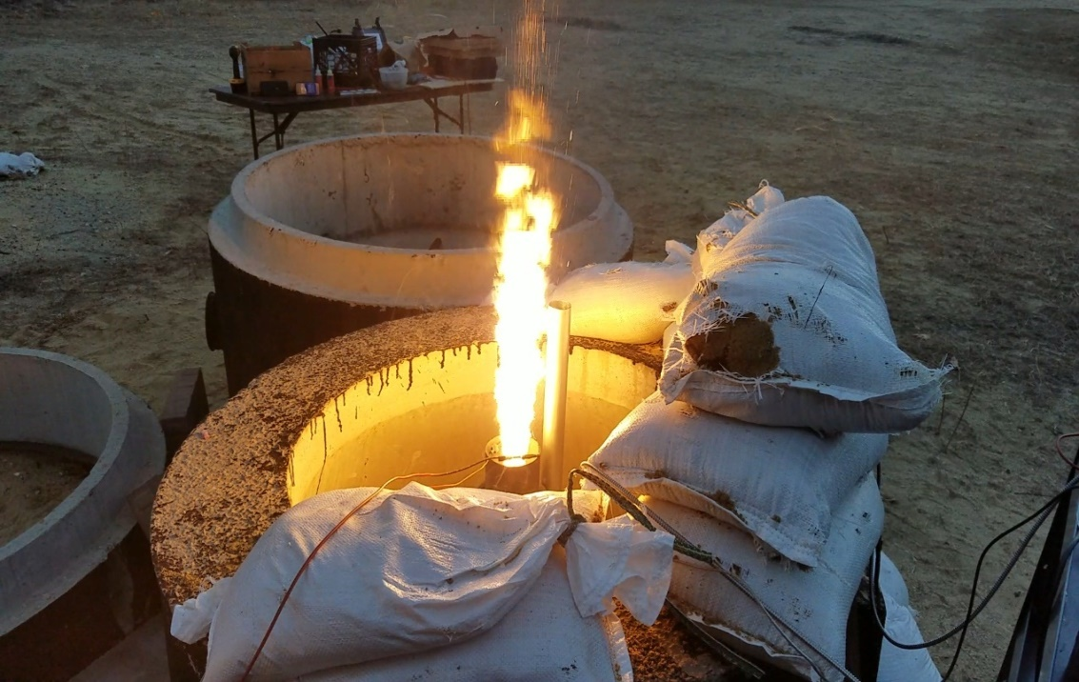
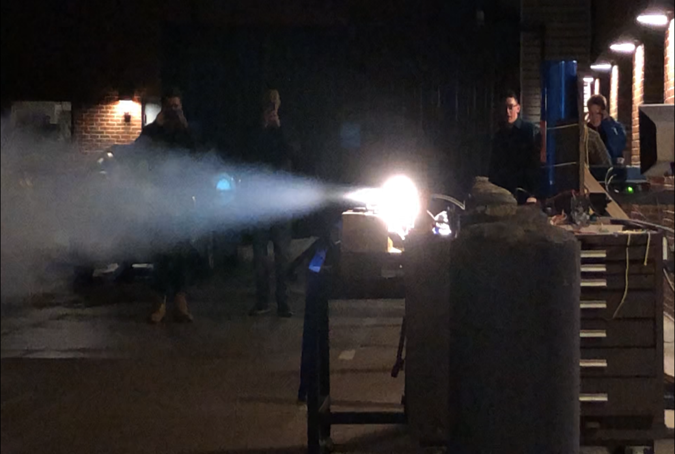
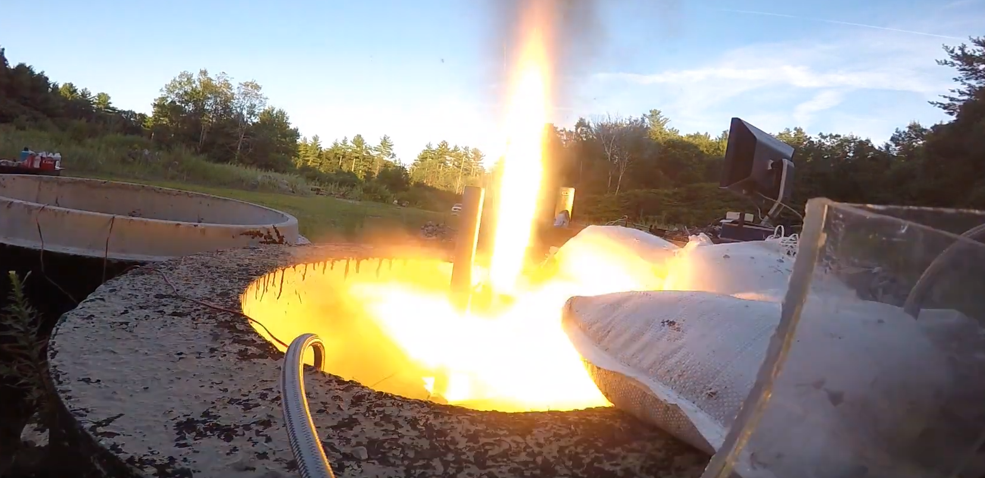
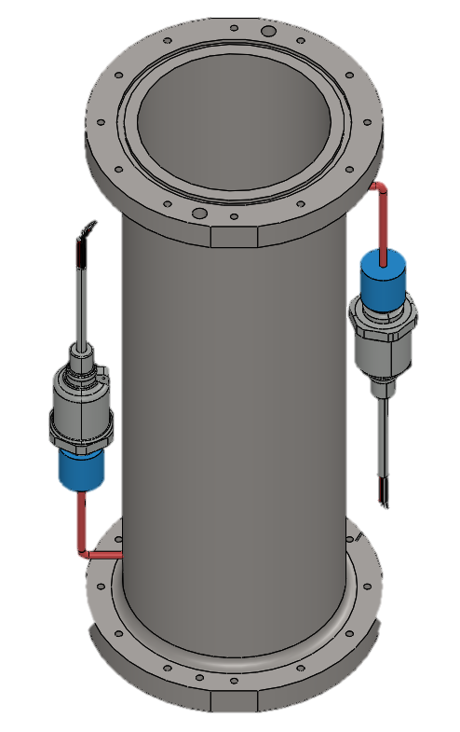
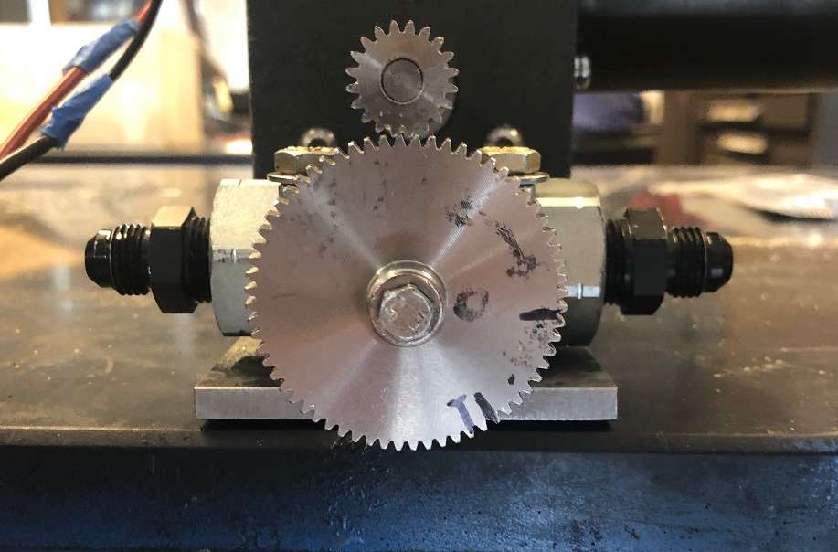
Journey to Spaceport
Authors: Thomas Collins, Silas Johnson, Charlie Nitschelm, Zach Raboin, Lucas Simmonds
Advisor: Dr. Todd Gross
Year 2 – 2018/2019
Year 1 – 2017/2018
Hybrid Engine
Engine Design
Manufacture
Test
Year 3 – 2019/2020
Rocket Building
Simulating
Launching
Optimizing
Hybrid Rocket
Spaceport America Cup
Rocket Vehicle
Engine Optimization
Drogue Parachute
A small parachute deployed at sustainer apogee
Oxidizer Tank
A highly pressurized vessel that
contains liquid Nitrous Oxide
Nose Cone
A nose cone that houses the drogue parachute and connects directly to the electronics bay
Flow Regulator
A motorized valve that monitors flow regulation
of the oxidizer
Electronics Bay
Houses the TeleMega GPS and controls both parachute deployment and sustainer ignition
Avionics
An electronics module responsible for GPS tracking, engine ignition and flow control
Sustainer Parachute
A larger main parachute that
slows the sustainer to a safe landing speed
Injection Plate
Responsible for providing desired oxidizer flow into the combustion chamber
Research Payload
A payload built in-house to collect data
Sustainer Engine
Propels the rocket to max altitude after booster burnout; 1.7 second burn time
Forward Fins
Provides stability to
the sustainer after stage separation
Impinging Plate
An interchangeable cylindrical plate responsible for the impingement of the oxidizer
Recovery System
A recovery module that is deployed at apogee
Oxidizer Storage
A pressurized vessel holding the liquid oxidizer
Staging Coupler
Supports stage separation at sustainer ignition
Chamber
An enclosed volume where the solid reducer and liquid oxidizer react
Booster Parachute
A large parachute to slow the booster to a safe landing speed
Throttle Control
A flow regulation system to insert oxidizer flow into the chamber
Aft Fins
Provides stability to the rocket before stage separation
Runaway
New Hampshire’s first hybrid rocket engine that utilizes a liquid oxidizer and solid fuel
Booster Engine
Initiates flight with a
0.7 second burn time
Nozzle
A de Laval curve responsible for directing the flow of hot gases outside of the combustion chamber

Slide 2
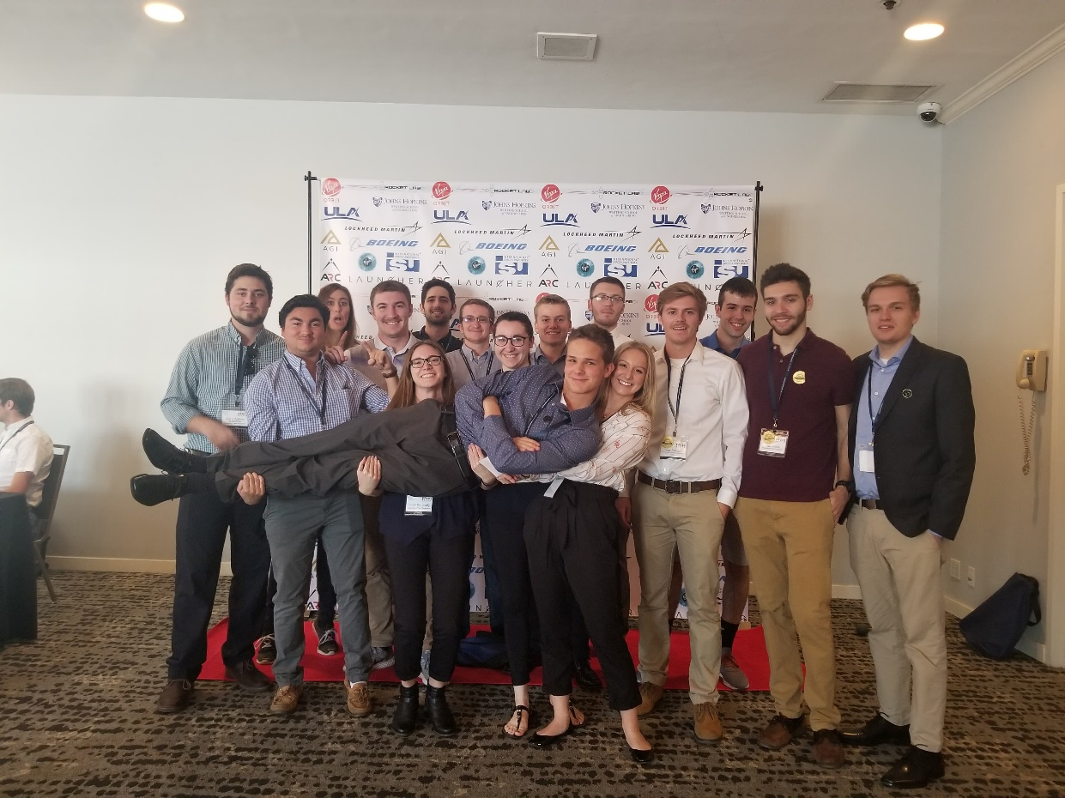
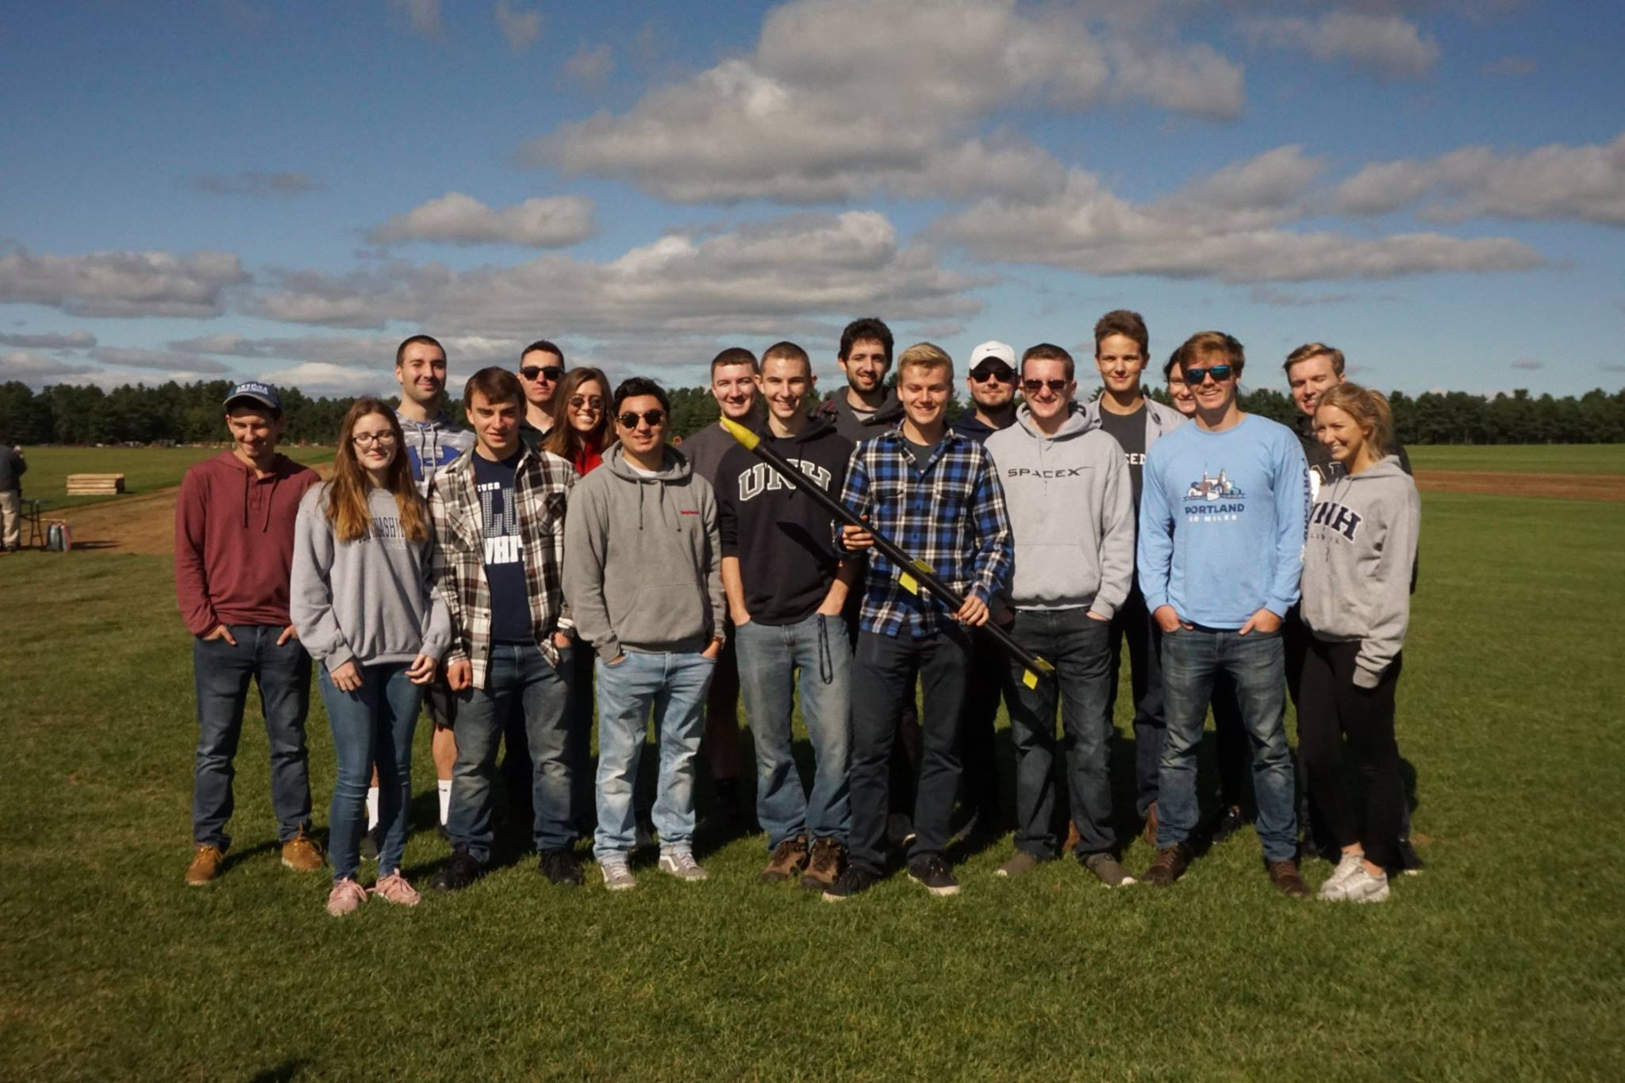


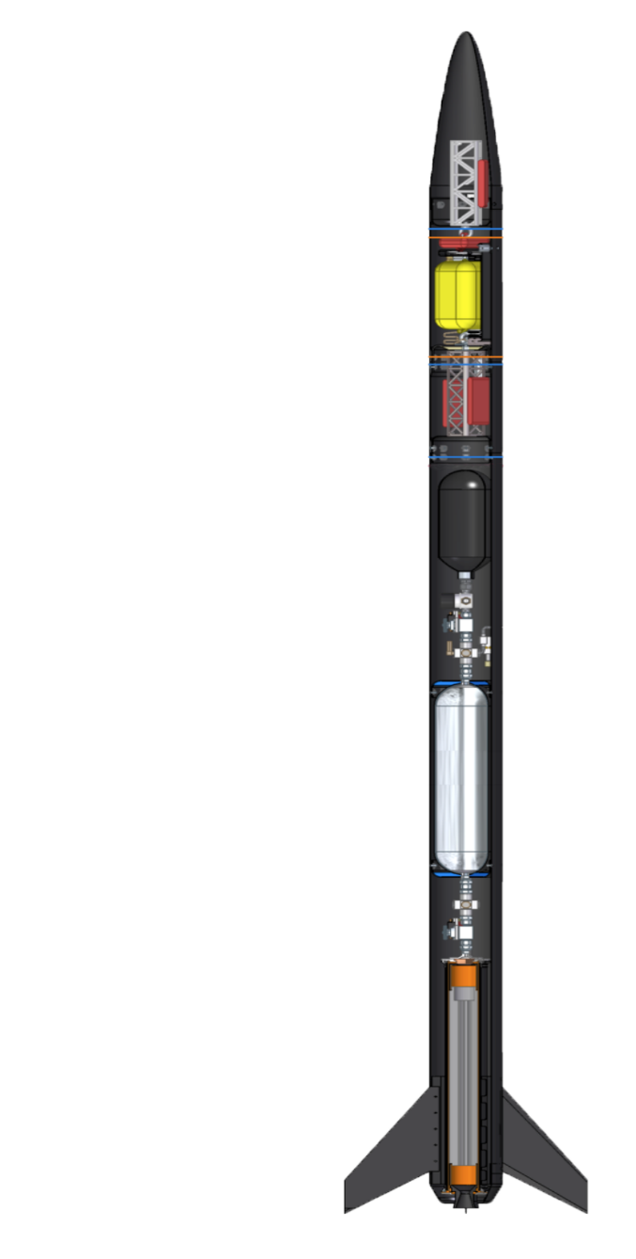
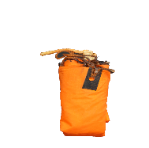
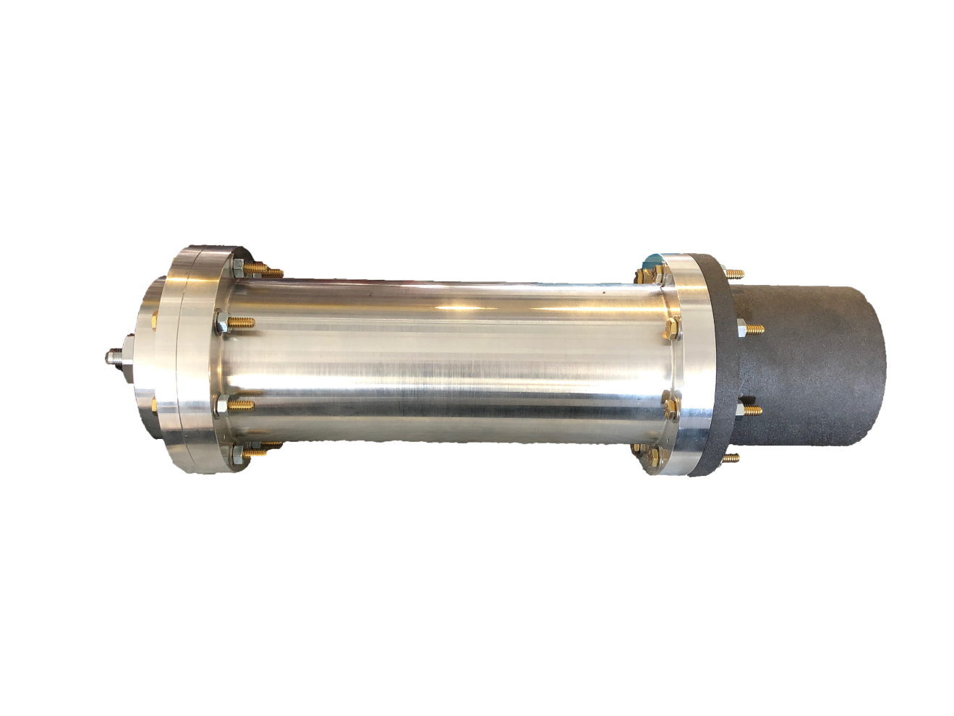

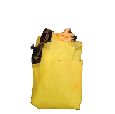

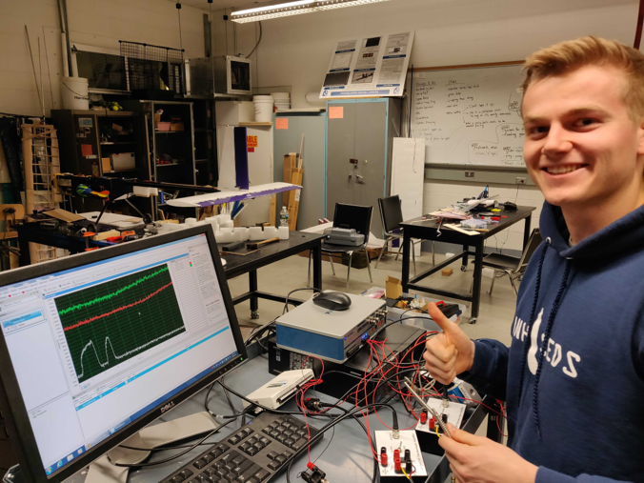
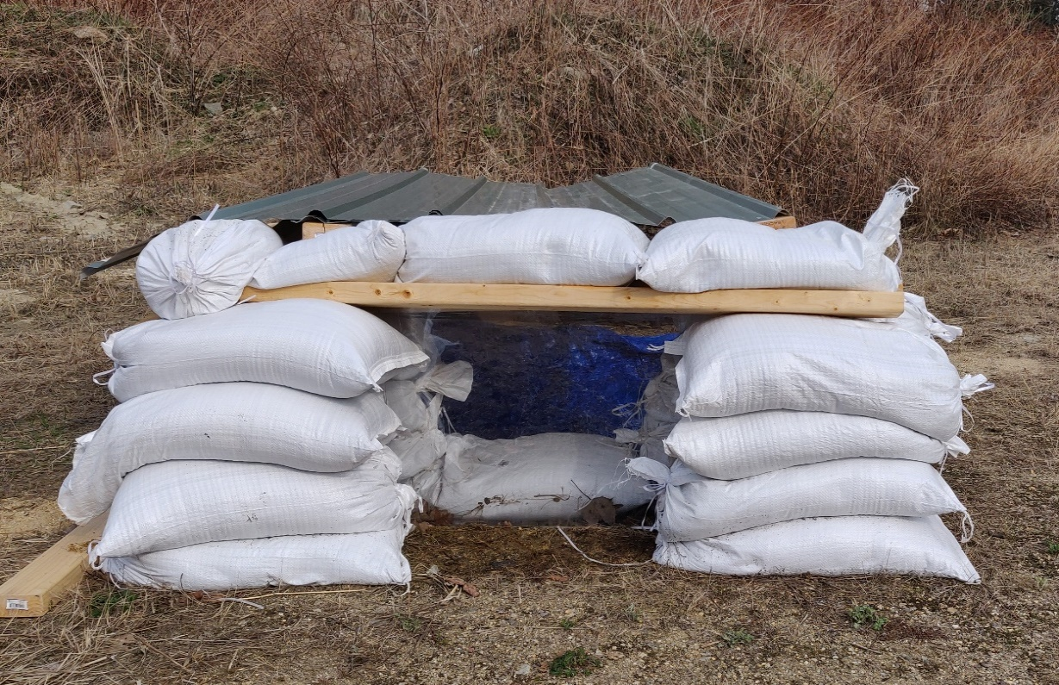
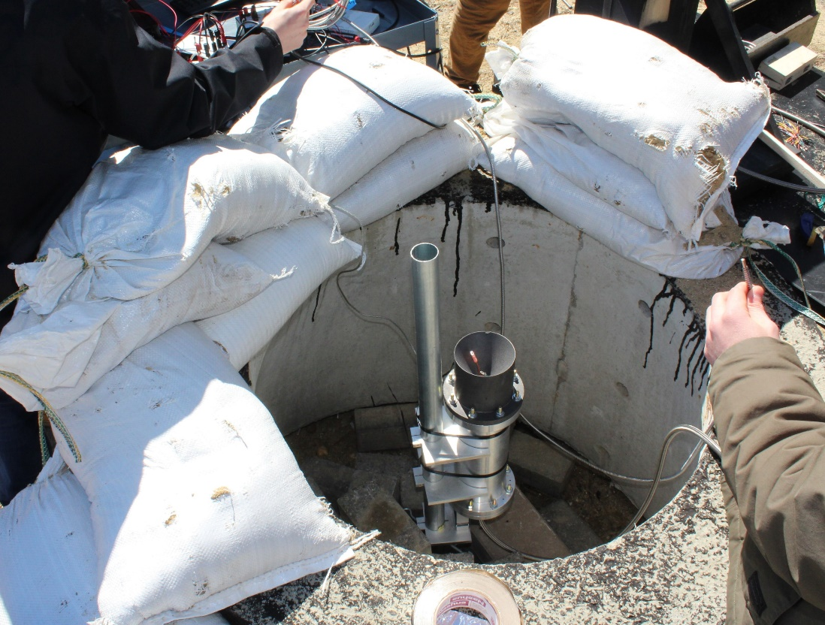
Who We Are
A second year engineering organization comprised of students of all classes and CEPS majors
A primary engineering goal of pursuing the art of high power rocketry with custom-made hybrid engines
Oxidizer Tank
A highly pressurized vessel that
contains liquid Nitrous Oxide
Drogue Parachute
A small parachute deployed at sustainer apogee
Flow Regulator
A motorized valve that monitors flow regulation
of the oxidizer
Nose Cone
A nose cone that houses the drogue parachute and connects directly to the electronics bay
SpaceVision, November 2018
SEDS Rocketry Competition, October 2018
Electronics Bay
Houses the TeleMega GPS and controls both parachute deployment and sustainer ignition
The 3 Year Plan
Year One
Year Three
Injection Plate
Responsible for providing desired oxidizer flow into the combustion chamber
Sustainer Parachute
A larger main parachute that
slows the sustainer to a safe landing speed
Hybrid Engine
Design
Manufacture
Test
Sustainer Engine
Propels the rocket to max altitude after booster burnout; 1.7 second burn time
Impinging Plate
An interchangeable cylindrical plate responsible for the impingement of the oxidizer
Runaway
Forward Fins
Provides stability to
the sustainer after stage separation
Rocket Building
Simulating
Launching
Optimizing
Hybrid Rocket
Engine Optimization
Rocket Integration
Competition
Chamber
An enclosed volume where the solid reducer and liquid oxidizer react
Year Two
Staging Coupler
Supports stage separation at sustainer ignition
Hot Fire Test
Booster Parachute
A large parachute to slow the booster to a safe landing speed
Worked with the UNH police and fire departments to locate a safe testing range and procedures.
Test engine to determine thrust, mass flow rate, combustion temperature and overall functionality.
Load cells and thermocouples were used to record data required for future optimization.
Designed and manufactured a static test fire rig to secure the engine and withstand a force up to 500 lbs of thrust.
Three hot fire tests were attempted, but due to weather, failed ignition and flow regulation a successful test has yet to be completed.
Aft Fins
Provides stability to the rocket before stage separation
Nozzle
A de Laval curve responsible for directing the flow of hot gases outside of the combustion chamber
Booster Engine
Initiates flight with a
0.7 second burn time

Slide 3


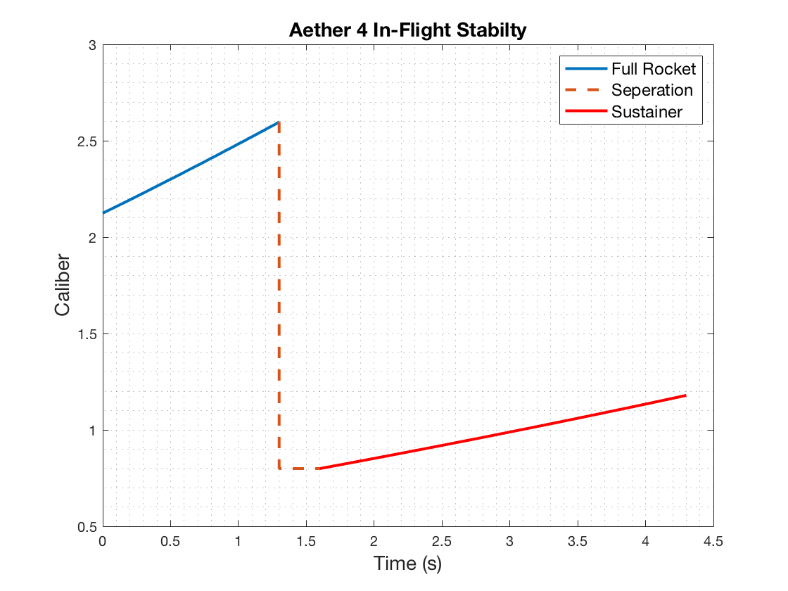


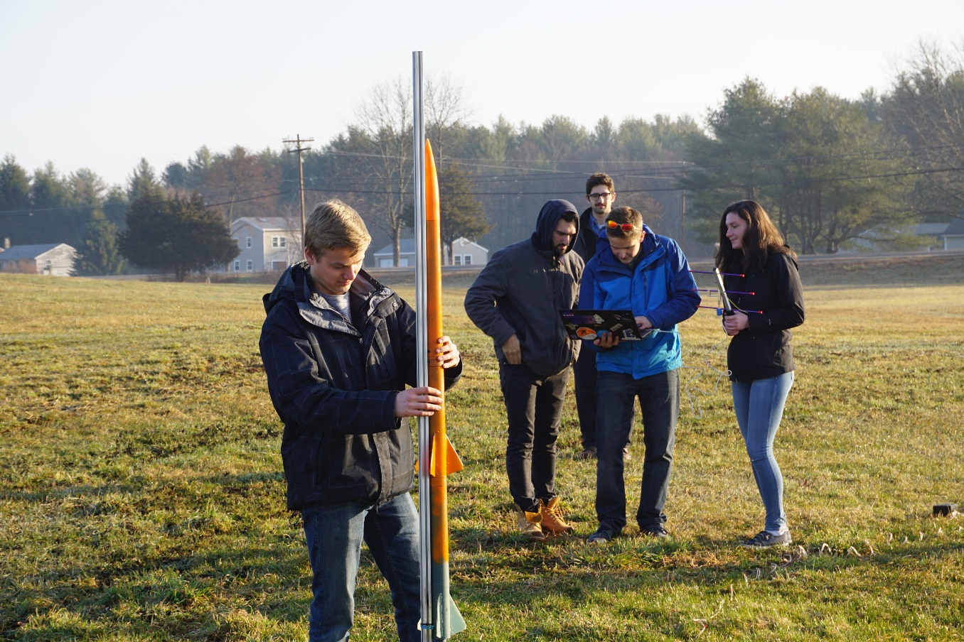
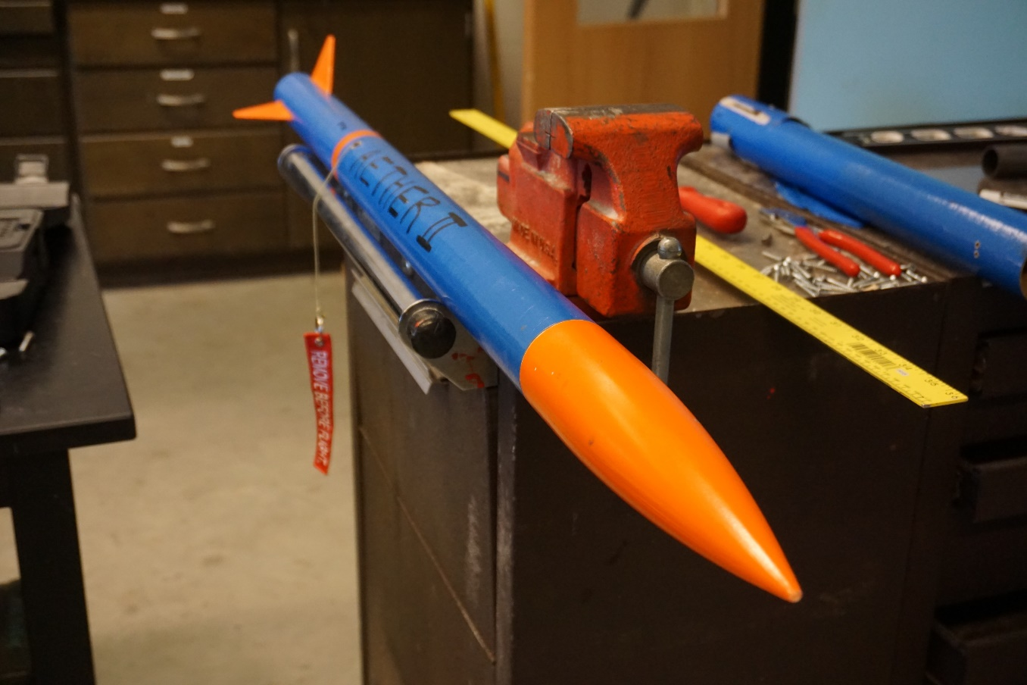

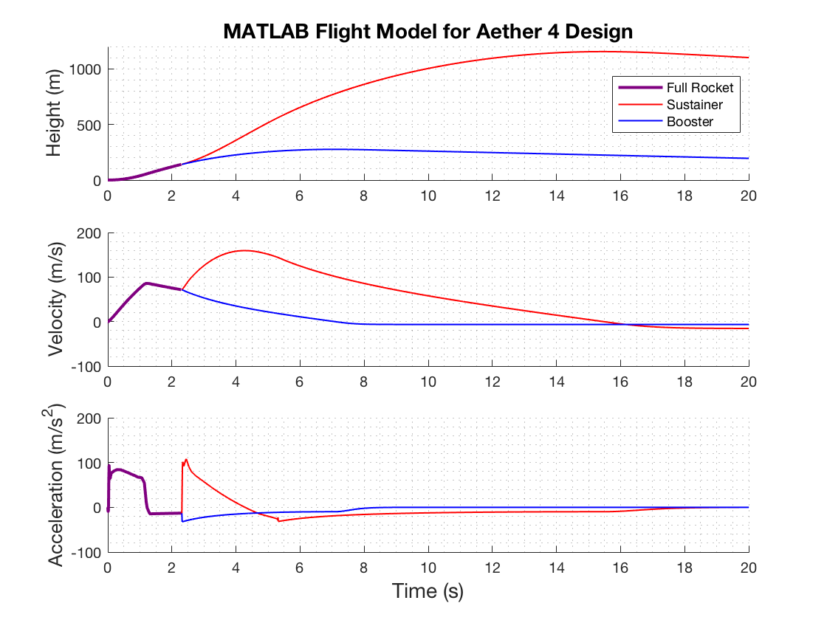


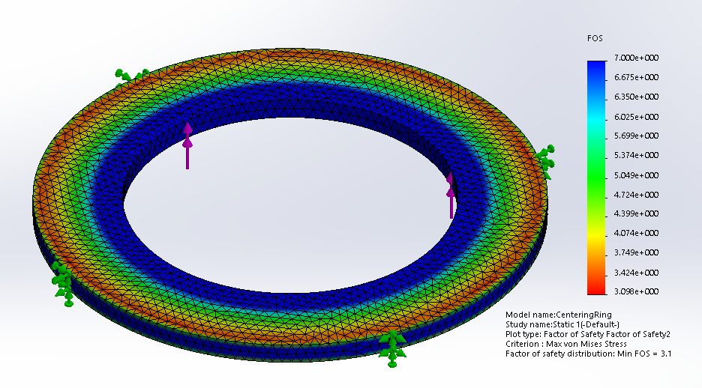
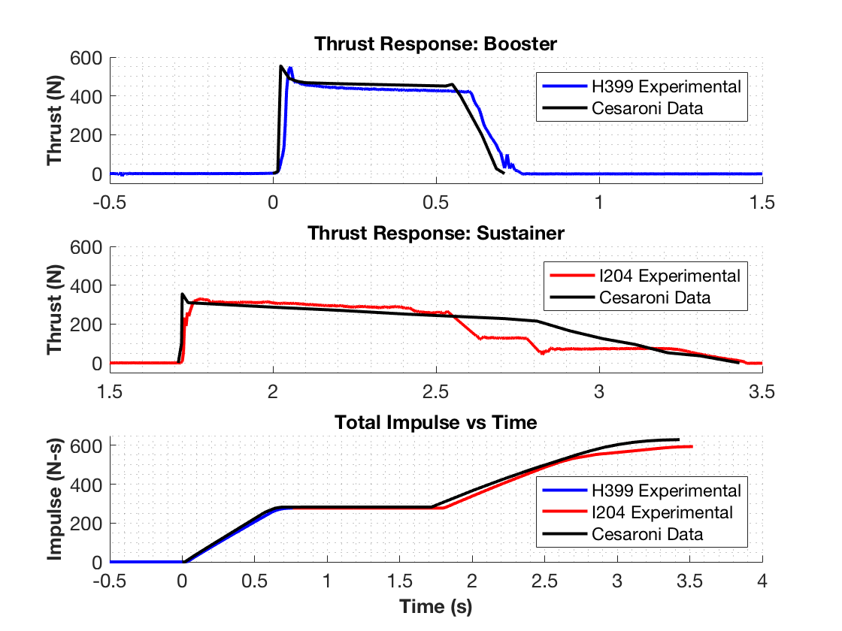
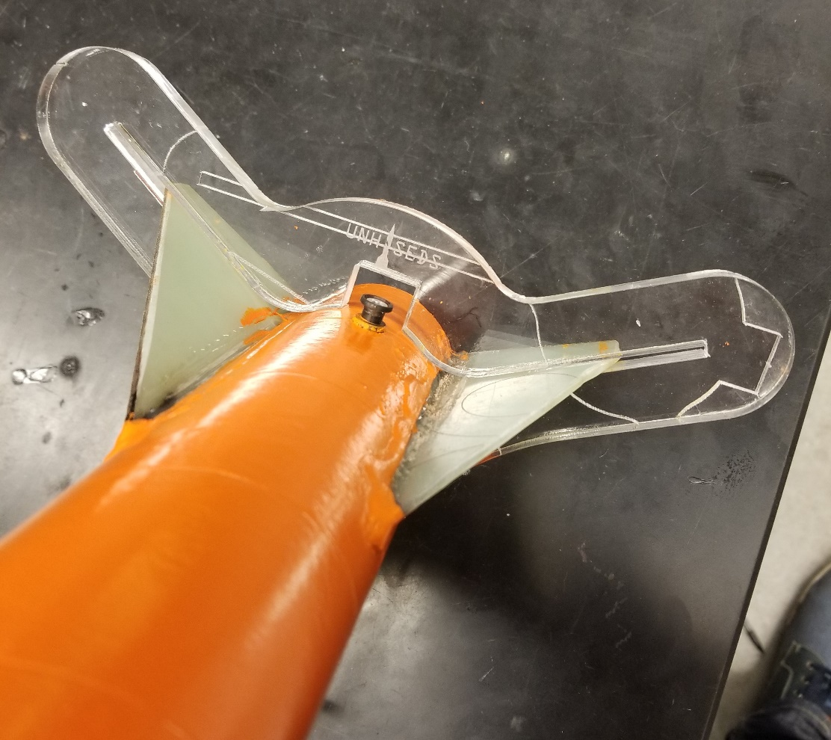
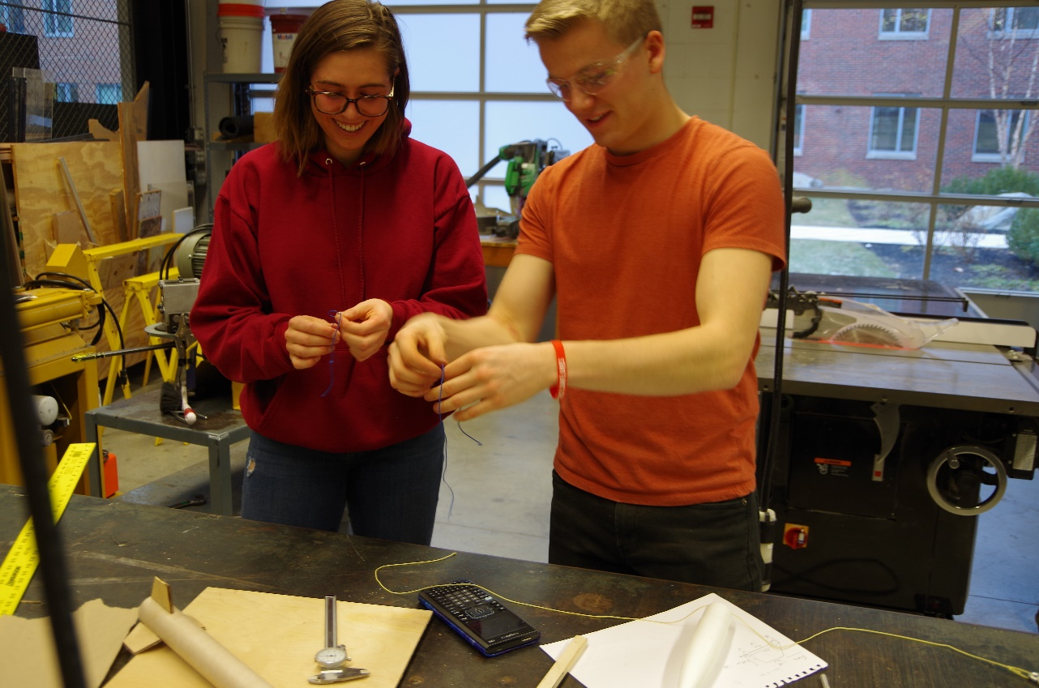
Department of Mechanical Engineering
Authors: Charlie Nitschelm, Kevin Bucher, Nick Clegg, Reilly Webb
Advisor: Dr. Todd Gross
Project Overview
To design, manufacture, and launch a high-powered, multi-stage rocket for the SEDS University Student Rocketry Competition
Goals
Design a high-powered engine class rocket to achieve maximum altitude
Implement a comprehensive recovery system that results in a fully reusable rocket
Constraints
Total combined engine impulse must not exceed 640.0 N-s
Must have at least two propulsion stages
Launch Simulation
Drogue Parachute
A small parachute deployed at sustainer apogee
Rocket trajectory was simulated using MATLAB. This required accurate stability, thrust, drag, and atmospheric models to produce ordinary differential equations that are then numerically solved for given rocket dimensions
Caliber is a measure of passive stability, and should remain between 1-3 for stable flight (right)
Custom Nose Cone
A carbon fiber nose cone that houses the drogue parachute and connects directly to the electronics bay
Electronics Bay
Houses the TeleMega GPS and controls both parachute deployment and sustainer ignition
Sustainer Parachute
A larger main parachute that
slows the sustainer to a safe landing speed
 | Flight Data | OpenRocket Model | MATLAB Model
Sustainer Apogee | 1071.1 m | 1020.6 m | 1154.1 m
Booster Apogee | 290.0 m | 238.6 m | 276.3 m
The MATLAB flight model is verified by comparing results to flight data from launches and to OpenRocket predictions (a pre-existing rocket simulation program)
Sustainer Engine
Propels the rocket to max altitude after booster burnout; 1.7 second burn time
Avionics
An electronics module responsible for GPS tracking, engine ignition and flow control
Forward Fins
Provides stability to
the sustainer after stage separation
Check Integrity with Finite Element Analysis
Research Aerodynamic Theory
Optimize Rocket Dimensions
Research Payload
A payload built in-house to collect data
Staging Coupler
Supports stage separation at sustainer ignition
Improve
Aerodynamic Models
Rocket Improvement Cycle
Manufacture and Assemble
Booster Parachute
A large parachute to slow the
booster to a safe landing speed
Recovery System
A recovery module that is deployed at apogee
Design & Analysis
An optimization program was created to determine the nominal dimensions for each component that will result in the highest simulated altitude.
Oxidizer Storage
A pressurized vessel holding the liquid oxidizer
An optimization program was created to determine the nominal dimensions for each component that will result in the highest simulated altitude
Launch and Gather Data
Improve Manufacturing Techniques
Booster Engine
Initiates flight with a
0.7 second burn time
This was achieved by maximizing the height output from the combined aerodynamic models through nonlinear programming using the interior-point algorithm
Improve Field Launch Techniques
Aft Fins
Provides stability to the rocket before stage separation
Throttle Control
A flow regulation system to insert oxidizer flow into the chamber
Optimization Constraints:
Maintain in-flight stability
Structural integrity factor of safety of at least 3.0
Manufacturing limitations
Propulsion
A Static Test Fire Rig was designed and manufactured to test the propulsion characteristics of each engine and to verify total engine impulse stays below 640.0 N-s
Runaway
New Hampshire’s first hybrid rocket engine that utilizes a liquid oxidizer and solid fuel
 | Reported Max Thrust | Measured Max Thrust | Reported Total Impulse | Measured Total Impulse
Booster Engine: Cesaroni H399 | 545.8 N | 549.6 N | 282.2 N-s | 277.1 N-s
Sustainer Engine: Cesaroni I204 | 356.8 N | 329.7 N | 347.7 N-s | 322.7 N-s
Manufacturing
Stress analyses are performed on the optimized components that are prone to failure, such as the engine centering ring (left)
A laser cut fin alignment tool was designed to keep fins in place during the epoxy curing process
Many components are assembled from scratch such as the nosecone, fins, ignition leads, ejection charges, and launch pad
Data acquisition was performed using the custom test rig, a 150 lb load cell, and NI SignalExpress software
Results were verified by comparing to official data reported by the engine manufacturer
Optimization must be reconfigured if resulting FOS is less than 3.0
Acknowledgments
A huge thanks to all the members of UNH SEDS, Prof. Martin Wosnik, Alireza Ebadi, Thomas Collins, the Parents Association, and our advisor Todd Gross for all the support

